Slide 1


How to Avoid Costly Mistakes in Hiring Staff
Mini Project 2
Len Kwok

Slide 2


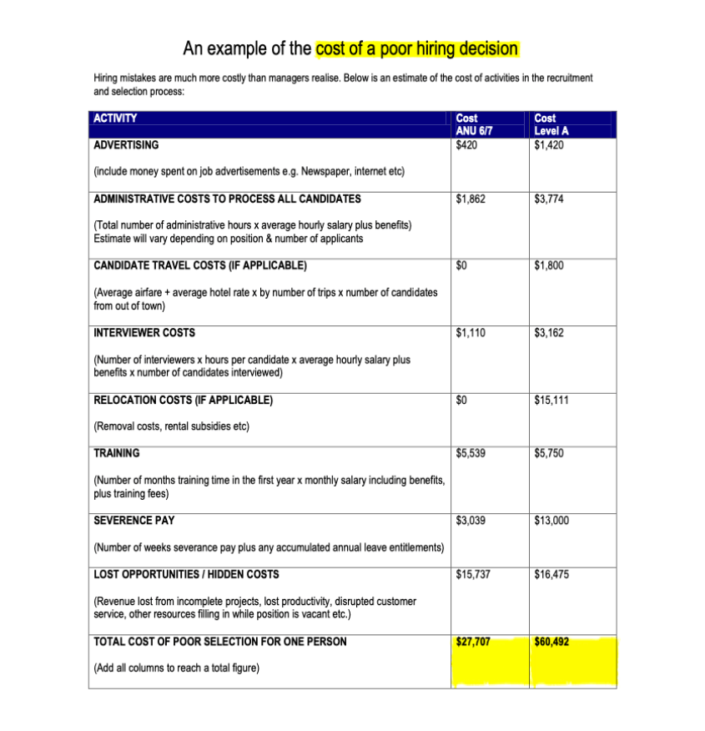
ANU's Hiring Costs
https://services.anu.edu.au/human-resources/recruit

Slide 3

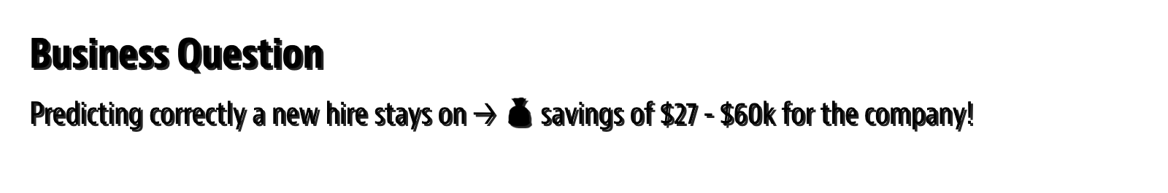


Business Question
Predicting correctly a new hire stays on → 💰️ savings of $27 - $60k for the company!
Data Question
What meaningful data can we extract from human resource department?
Stakeholders: Everyone who works in the company & investors.

Slide 4
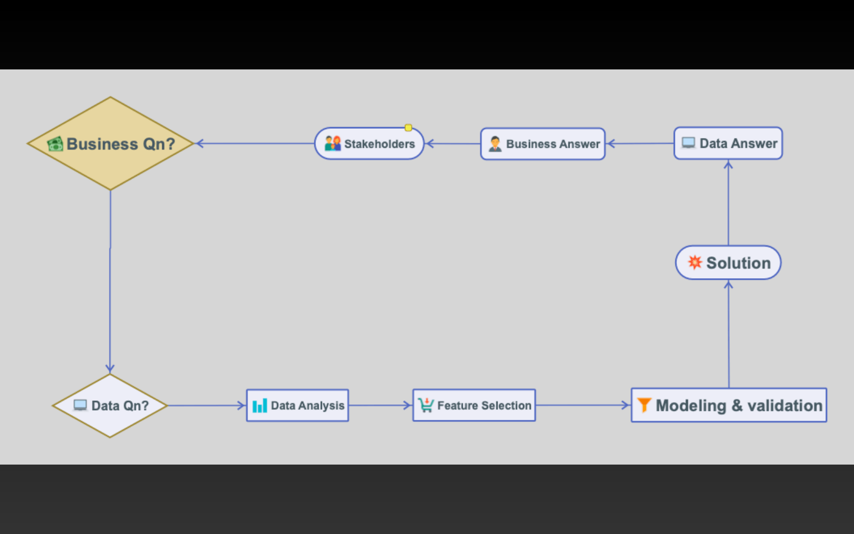

Project Pipeline

Slide 5


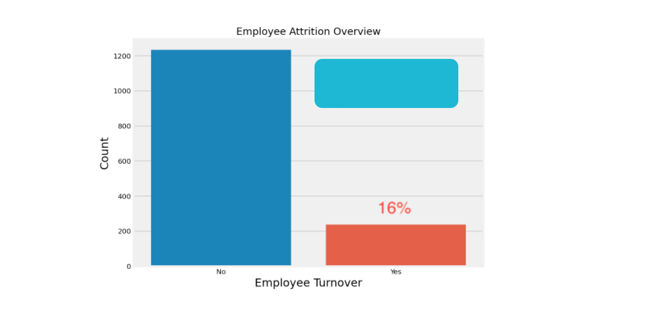

Attrition Rate
How many employees actually left the company?
$9 million gone 😱

Slide 6

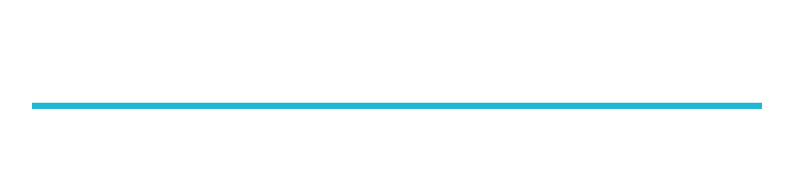

Features - HR data and survey
Age
Education Field
Job Involvement
Num Companies Worked
Stock Option Level
Business Travel
Employee Count
Job Level
Over 18
Total Working Years
Daily Rate
EmployeeNumber
Job Role
OverTime
Training Times Last Year
Department
Environment Satisfaction
Job Satisfaction
Percent Salary Hike
Work Life Balance
Distance From Home
Gender
Marital Status
Performance Rating
Years At Company
Education
Hourly Rate
Monthly Income
Relationship Satisfaction
Years In CurrentRole
Years With Curr Director
Monthly Rate
Standard Hours
Years Since Last Promotion

Slide 7
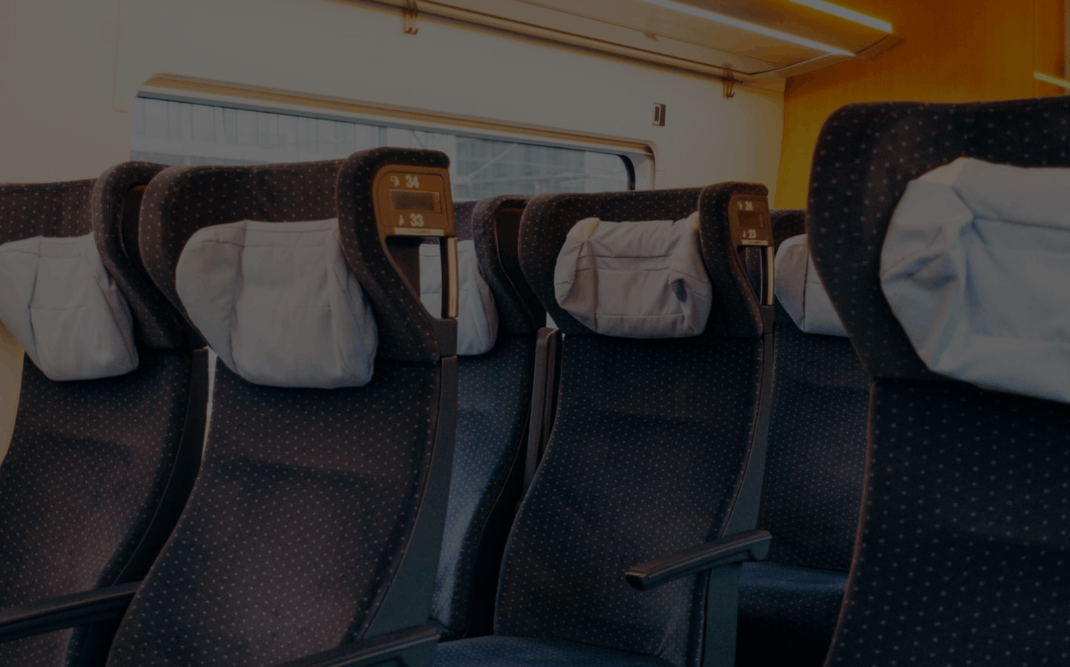

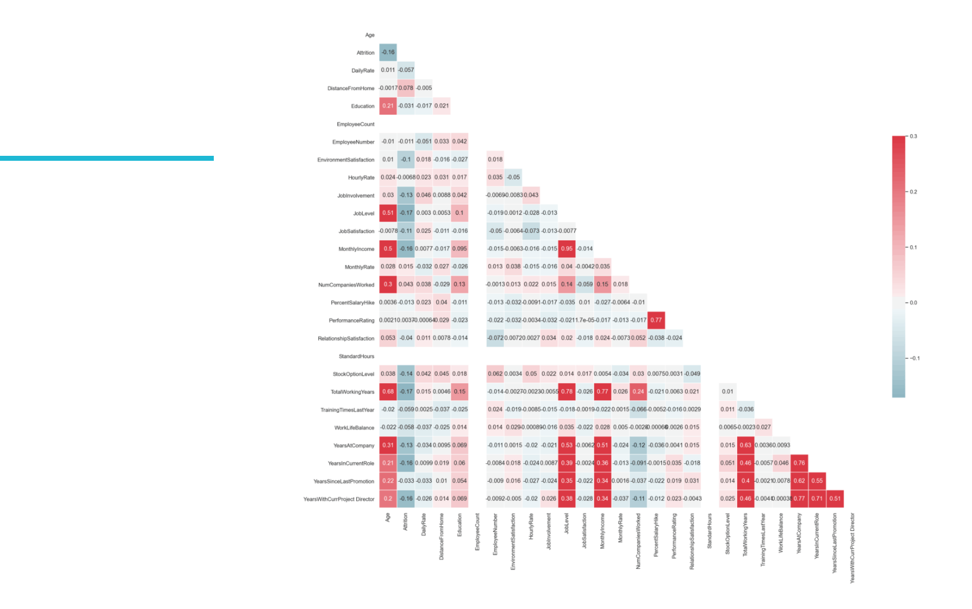
Features Selection
Get overview

Slide 8

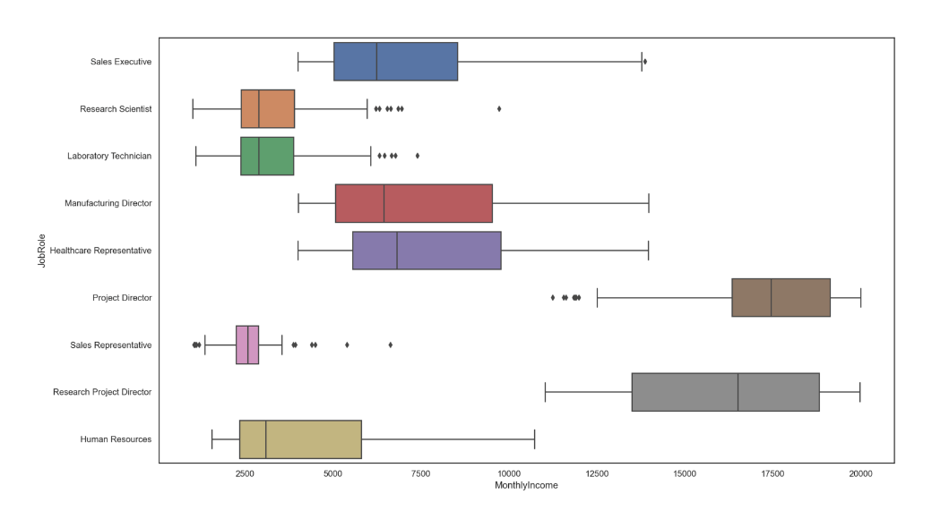
Visualisation
Who earns the most...and least?

Slide 9

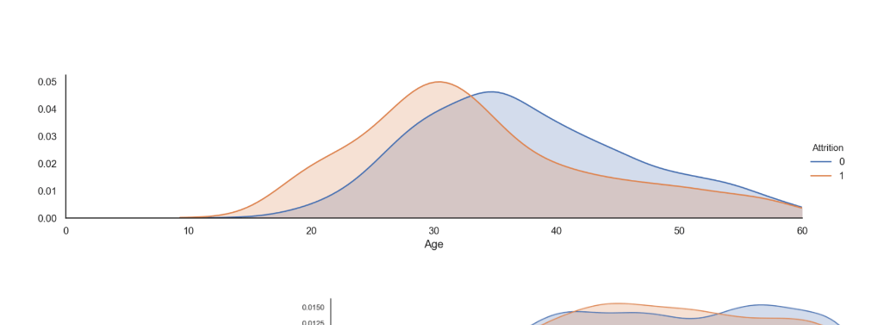
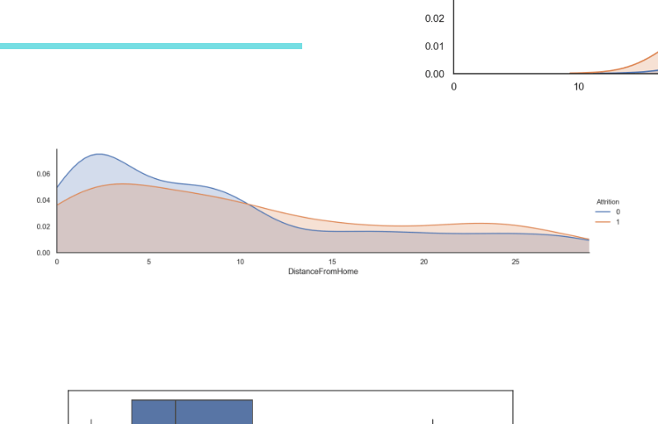
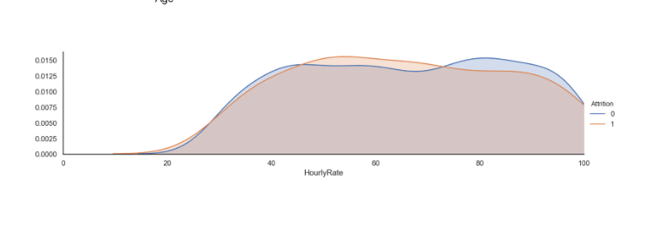
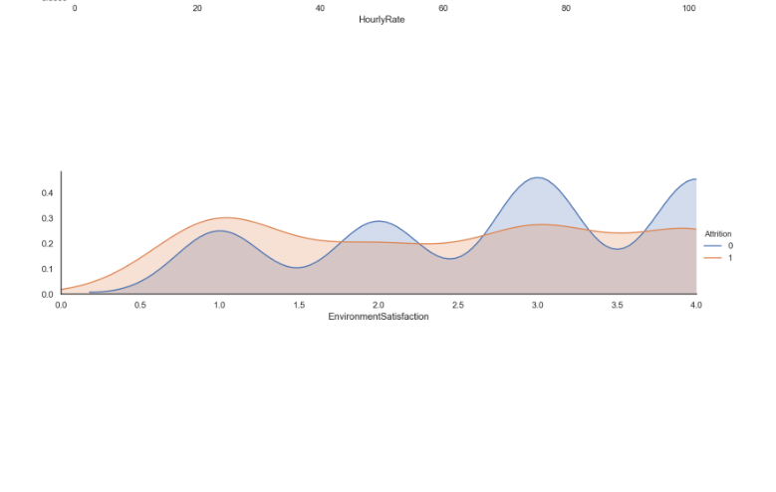
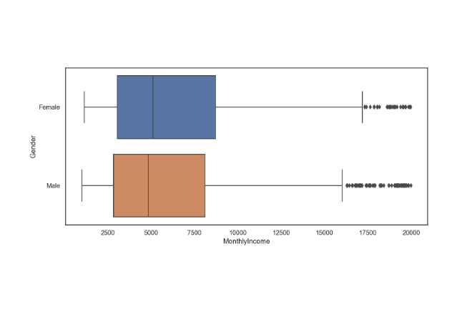
Data Exploration and Visualisation

Slide 10
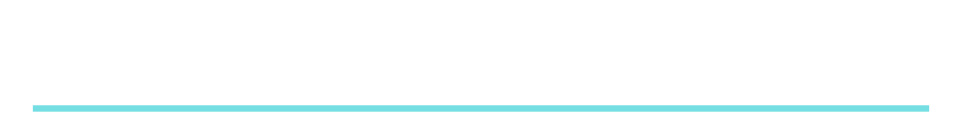
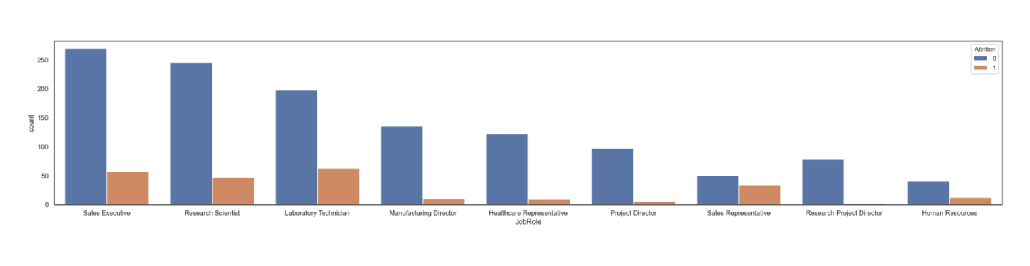
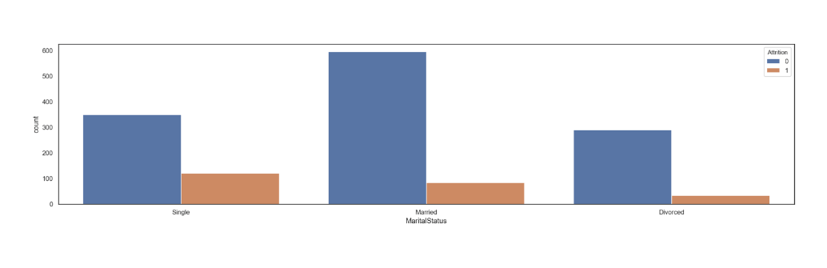
Impact of Variables on Attrition Rate

Slide 11
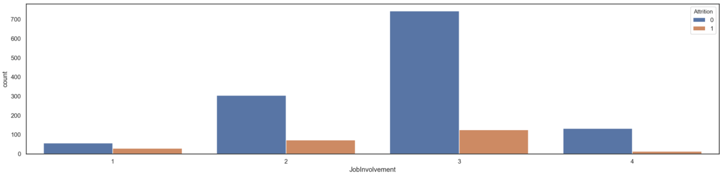
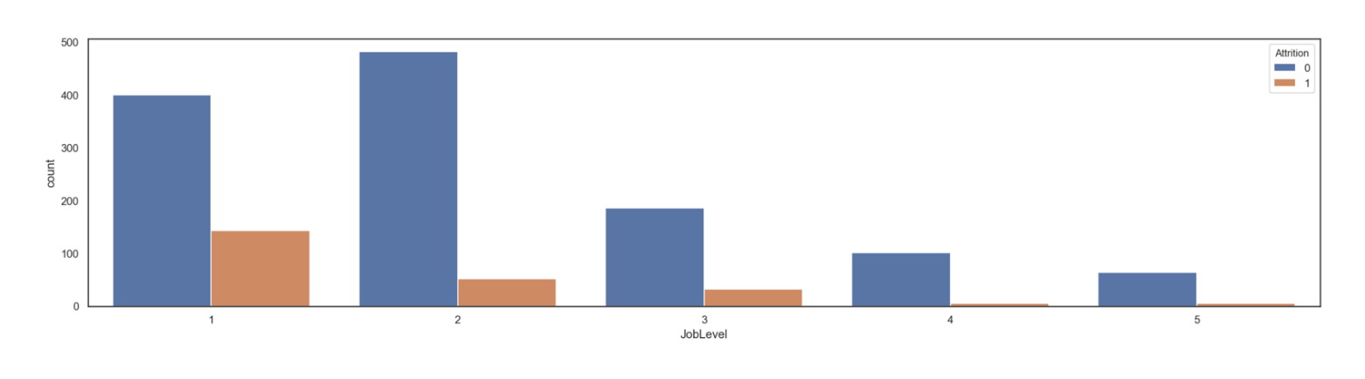
Impact of Variables on Attrition Rate

Slide 12

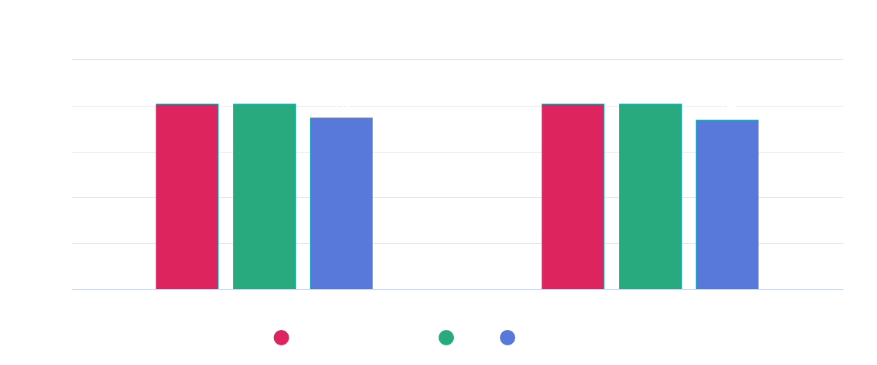

Predictive Models
What's their accuracy in predicing attrition rate?
81% accuracy in predicting whether an employee is staying or leaving.

Slide 13

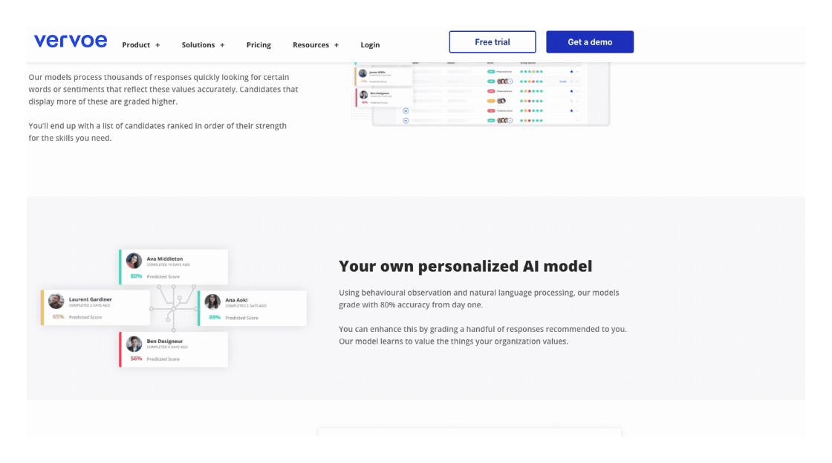
Our Results vs Industry Software
Heard of Vervoe?
https://vervoe.com/

Slide 14


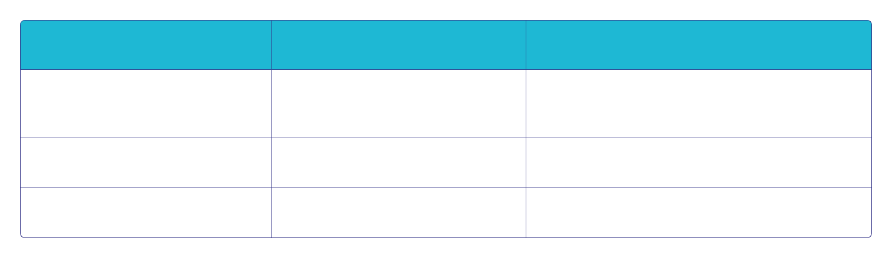
Summary
Data
Approach
Outcomes
1,470 employees from HR records.
Used as many features as possible.
Tried 3 models. Attrition rate up to 81% accuracy.
Target variable: Attrition Rate.
Predicted attrition rate.
Compared with industry software.
34 features.

Slide 15





Conclusion
Last year, 166 employees left, costing company $9 million.
Modeling predicts with 81% accuracy the attrition rate for 1,470 employees.
At 81% accuracy, potential savings $7.2 million 💰
Next steps? Include other models. Fit more data.

Slide 16


Thank you for listening!

